Slide 1

D.Y Patil College of Engineering, Akurdi, Pune-44
Department of Information Technology
TE INTERNSHIP REVIEW (2022-2023)
In-charge: Ms. Priyanka Gupta
Guide: Ms. Amita Jajoo
Presented By:
Harshita Totala
TEITA14

Slide 2

INTERN CROWD:
Intern Crowd Is An Online Coding Platform that Offers Specially Programming Courses For Students.
Their main aim is what’s a better approach for students is to grasp and adapt to the technology around them.
Also to gain experience in various domains and choose their career path by gaining new skills and knowledge and strengthening the resume.
Prachi Patil, CEO Intern Crowd

Slide 3

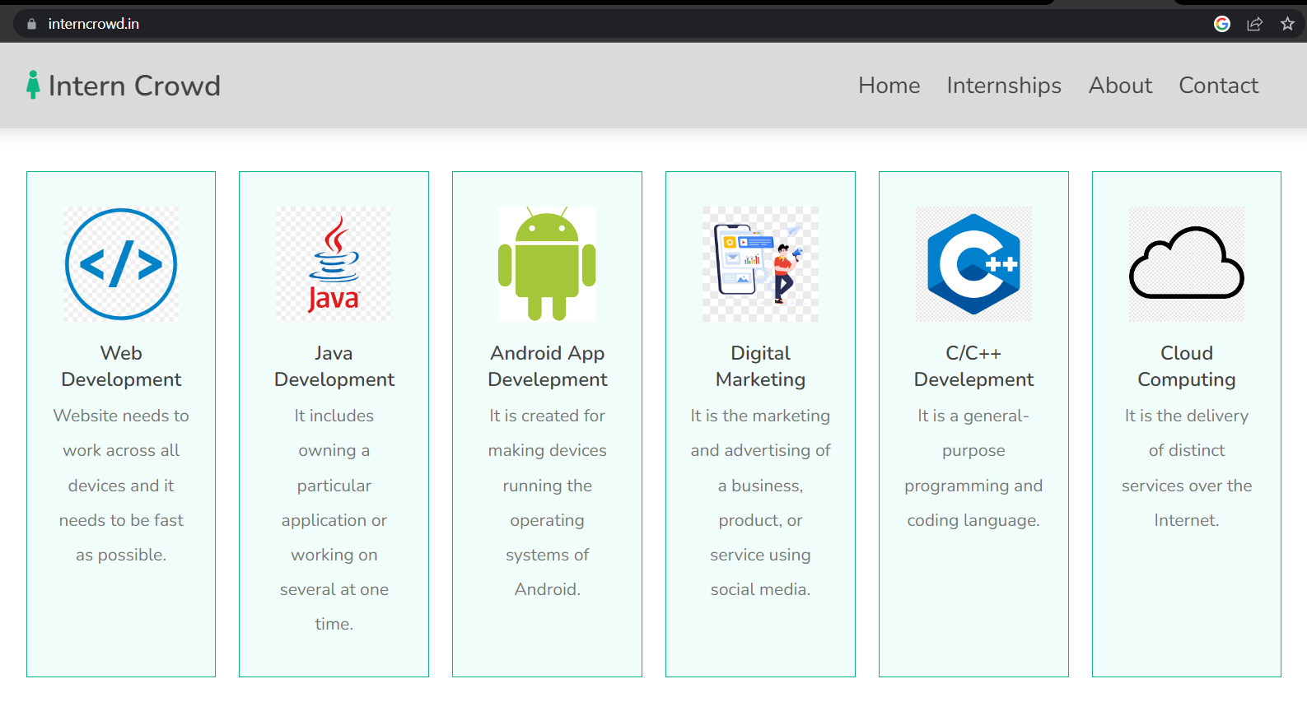
INTERN CROWD INTERNSHIPS -

Slide 4

TASK -1 : HOST A STATIC WEBSITE WITH S3
The static web content including HTML, CSS, JavaScript, images and other files will be stored in Amazon S3.
The end users will then access the site using the public website URL exposed by Amazon S3.
No need to run any web servers or use other services in order to make the site available.

Slide 5
Steps:
1)First created a simple static website- attendance system using HTML, CSS, JS.
2)Go to AWS Management Console, select a region.
3)Create an S3 Bucket
4)Upload the contents.
5)Add a bucket policy to allow public reads.
6)Enable web hosting.

Slide 6
TASK -2 : HOST A DYNAMIC WEBSITE ON EC2
When a web page is dynamic, users can engage in interactive user interactions.
In this project, host a dynamic website on Amazon Web Services (AWS) and use client-side and server-side languages such as CSS,PHP, HTML, ASP, and JavaScript in the website creation process.

Slide 7
Steps:
1)Select EC2 Instance from AWS Console.
2)Launch an EC Instance and configure the EC2 Instance.
3)Connect the EC2 with EC2 Instance Connect.
4)Upgrade the instance.
5)Clone the website repository into EC2.
6)Activate the virtual env and run the application using the public IP address

Slide 8
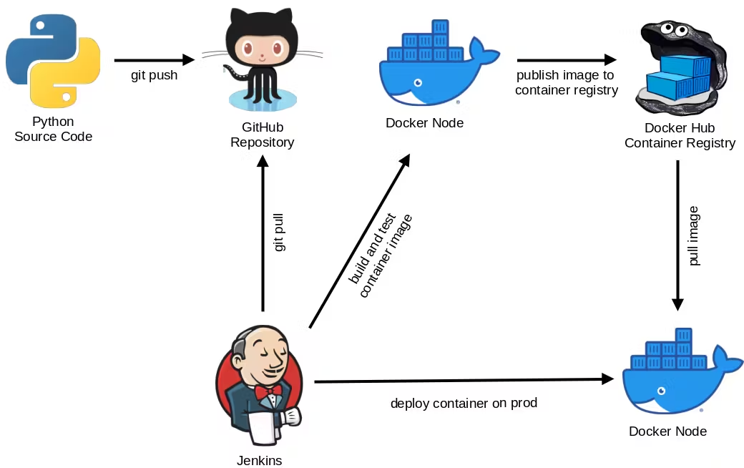
Automated CI/CD Pipeline For Django Web Application Using Github , Docker, Jenkins and AWS EC2

Slide 9
Automated CI/CD Pipeline For Django Web Application Using Github , Docker, Jenkins and AWS EC2
STEPS:
Git clone the website and run it on AWS EC2.
Create Docker Image And Containerize the Application.
- Make new Docker file named "Dockerfile“
Install Jenkins for Creating CI/CD Pipeline and start it.
Start to Making the CI/CD Pipeline
Making Jenkins and Github Integration
Finally Making CI/CD Pipeline

Slide 10
CONCLUSION:
This internship has been an excellent and rewarding experience.
The technical aspects of the work done are not flawless and could be improved provided enough time.
As someone with no prior experience ,discovering it was well worth it and contributed to finding an acceptable solution to build a fully functional web service.
But, the overall experience was positive, and everything learned would be useful in future career in this field.

Slide 11
REFERENCES:
[1]https://blog.sysfore.com/hosting-a-dynamic-website-on-aws/
[2]https://github.com/ashutoshvct/Hosting-dynamic-website-on-AWS/blob/master/EC2.md
[3] https://aws.amazon.com/websites/
[4] https://docs.aws.amazon.com/AmazonS3/latest/userguide/EnableWebsiteHosting.html
[5] https://docs.aws.amazon.com/AWSEC2/latest/UserGuide/concepts.html

Slide 12

Thank You!

